Slide 1
Chapter Nine
Wisdom and Courage
Positive Psychology: The Scientific and Practical Explorations of Human Strengths © 2014 SAGE

Slide 2
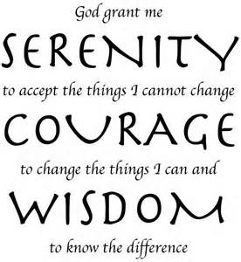
Serenity Prayer

Slide 3
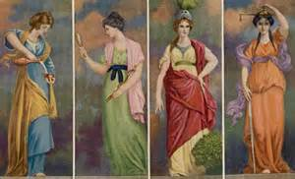
Wisdom and Courage
Often studied together, erroneously
Cardinal virtues (facilitate personal development)
  Temperance
    (Moderation and self-restraint)
  Prudence (Wisdom)
  Fortitude (Courage)
  Justice
Positive Psychology: The Scientific and Practical Explorations of Human Strengths © 2014 SAGE

Slide 4
Wisdom
Wisdom as a foundational strength and virtue
  A philosophical understanding of what matters in life, and
  The practice knowledge of how to conduct a life that matters
Positive Psychology: The Scientific and Practical Explorations of Human Strengths © 2014 SAGE

Slide 5
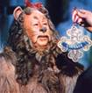
Wisdom and Courage
Wizard of Oz says to Lion: “You’re confusing courage with wisdom.”
Opinion: ordinary people can demonstrate both wisdom and courage
  Wisdom is sometimes seen as the predecessor of courage
  Other times, courage is seen as precursor of wisdom
Positive Psychology: The Scientific and Practical Explorations of Human Strengths © 2014 SAGE

Slide 6
Theories of Wisdom
3 distinct conceptualizations:
  That found in people seeking a contemplative life
  That of a practical nature
  Scientific understanding
Positive Psychology: The Scientific and Practical Explorations of Human Strengths © 2014 SAGE

Slide 7
Theories of Wisdom
Wisdom as a form of excellence in living displayed by ordinary people
OR
Wisdom as a fuzzy quality possessed only by sages
Positive Psychology: The Scientific and Practical Explorations of Human Strengths © 2014 SAGE

Slide 8
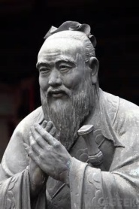
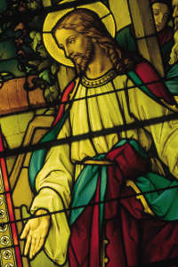
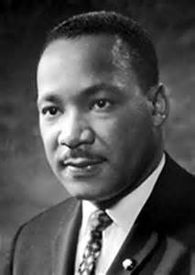
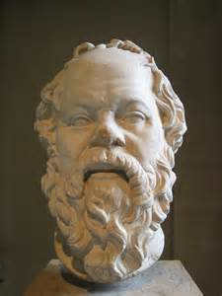
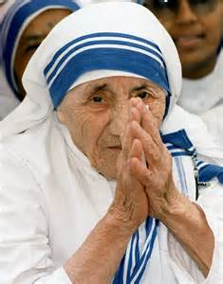
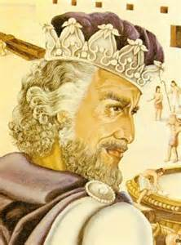
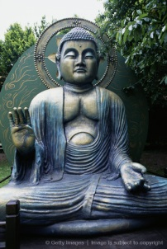
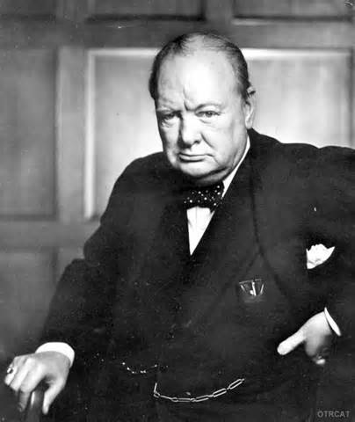

College Students View of Wise People
Top 15 People identified as wise:
  Gandhi, Confucius, Jesus Christ, ML King Jr., Socrates, Mother Theresa, Solomon, Buddha, Pope, Oprah Winfrey, Winston Churchill, Dalai Lama, Ann Landers, Nelson Mandela, Queen Elizabeth
Baumgartner and Crothers, 2009

Slide 9
College Students View of Wise People
6 Attributes that characterize a wise person
  Reasoning ability
    Look at problem and solve using logic, apply knowledge to problems, integrate info in new ways, possess much knowledge
  Sagacity (knowledge)
    Keen understanding of human nature, thoughtfulness, fairness, good listening abilities, knowledge of self, and placing value on advice and knowledge of others
  Learning from ideas and the environment
    Places value on ideas, is perceptive, and learns from others’ mistakes
Baumgartner and Crothers, 2009

Slide 10
College Students View of Wise People
6 Attributes that characterize a wise person
  Judgment
    Has good, sensible judgment at all times, takes a long-term view, and thinks before acting and speaking
  Expeditious use of information
    Learns and retains information from experience, willingness to change one’s mind based on new experience
  Perspicacity (perceptive)
    Demonstrates perceptiveness, intuition, ability to see through things, read between the lines; and discern the truth and the right thing to do
Baumgartner and Crothers, 2009

Slide 11
Explicit Theories of Wisdom
Robert Sternberg, Yale
- Explicit focus on behavioral manifestations of wisdom
- Balance Theory of Wisdom: “the processes (balancing of interests and of responses to environmental contexts) in relation to the goal of wisdom (achievement of a common good)”
Positive Psychology: The Scientific and Practical Explorations of Human Strengths © 2014 SAGE

Slide 12
Explicit Theories:
Sternberg’s Balance Theory
Posits that wisdom is based on tacit knowledge (knowing “how” rather than “what”) that is built up over time as we learn how to pursue and achieve valued goals
Tacit knowledge becomes foundation for wisdom when it is used to achieve a common good rather than a self-interested good, and when it is focused on finding ways to balance the often conflicting interests and choices involved in real-life situations.
Baumgartner and Crothers, 2009

Slide 13
Sternberg’s Balance Theory
Wise people are skillful in balancing 3 interests:
  One’s own interests and needs (intrapersonal)
  The interests and needs of important others like spouse, friend, or employer (interpersonal)
  Those related to community, country, environment, or religion (extrapersonal)
Balancing requires consideration of 3 courses of action concerning whether and how much individuals need to (a) change themselves (adaptation); (b) change their environment, including others; or (c) select a new environment altogether
Baumgartner and Crothers, 2009

Slide 14
Sternberg’s Balance Theory Example
“sandwich generation”
Situation: dual career couple, 2 children (college and HS sophomore); parents have significant health issues and cannot live by themselves much longer. Parents want to maintain independence and do not want to move to assisted living or nursing home. What would be a wise course of action?
Baumgartner and Crothers, 2009

Slide 15
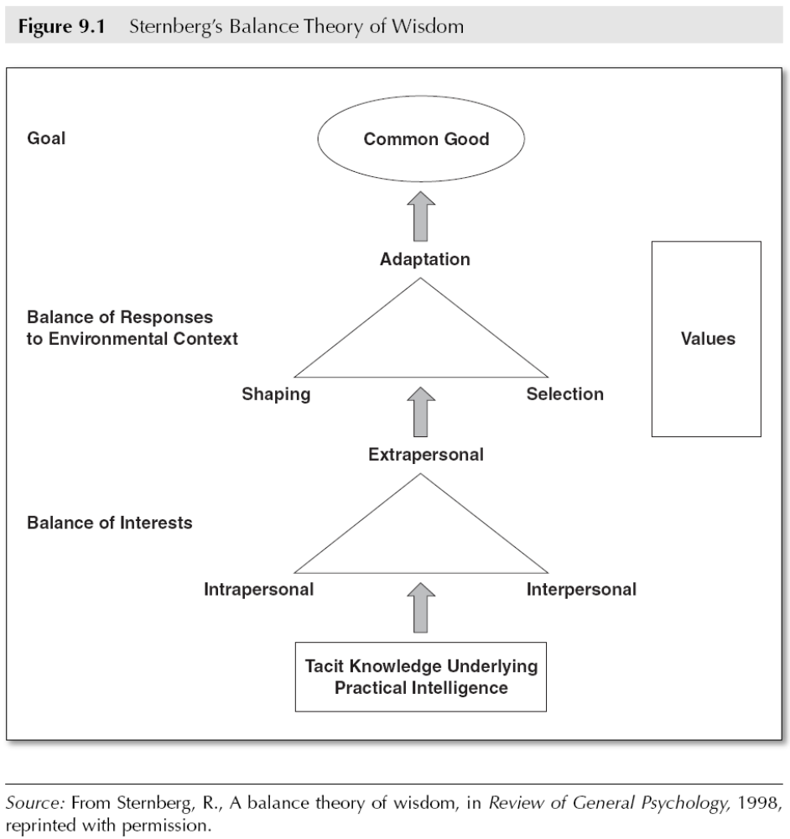
Explicit Theories of Wisdom
Positive Psychology: The Scientific and Practical Explorations of Human Strengths © 2014 SAGE
Notes:
Confirm correct numbering of this chart

Slide 16
Developing Wisdom
Many ideas of wisdom development:
- resolution of conflict/daily crises
- builds on knowledge, cognitive skills, and personality traits
- via exposure to wise models
- fluid intelligence, creativity, openness, and life experiences combined produce wisdom
Positive Psychology: The Scientific and Practical Explorations of Human Strengths © 2014 SAGE

Slide 17
Characteristics of Wise People
Experience greater life satisfaction
Quality of social life in early adulthood matters facilitates development of wisdom
Positive Psychology: The Scientific and Practical Explorations of Human Strengths © 2014 SAGE

Slide 18
Characteristics of Wise People
Wise acts often occur in public for men and in private for women
Begins in adolescence/young adulthood; declines in the late 70s
More common in clinical psychologists
Characteristics related to wisdom are cultivated more purposefully in some cultures
Positive Psychology: The Scientific and Practical Explorations of Human Strengths © 2014 SAGE

Slide 19
Benefits of Wisdom
Wisdom is associated with many positive psychological constructs:
Having a coherent sense of self
Having a solid and consistent ego
Less investment in hedonistic pursuits
More interest in reflection personal growth
Tendency to reserve social judgment in favor of greater understanding
Happiness and life satisfaction
Greater flexibility adaptation and change as life requires
Positive Psychology: The Scientific and Practical Explorations of Human Strengths © 2014 SAGE

Slide 20
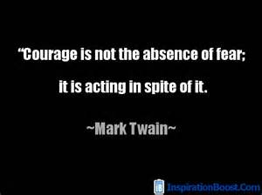
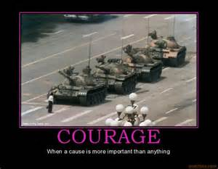
Theories of Courage
Courage appreciated in many cultures
At least18 different
conceptualizations of courage
Positive Psychology: The Scientific and Practical Explorations of Human Strengths © 2014 SAGE

Slide 21
Implicit Theories of Courage
O’Byrne, Lopez, & Peterson (2000)
- Courage perceived as:
an attitude
a behavior
mental strength
physical strength
risk-taking
role of fear
Positive Psychology: The Scientific and Practical Explorations of Human Strengths © 2014 SAGE

Slide 22
Implicit Theories of Courage
Values In Action system (Peterson and Seligman)
Courage (core human virtue) comprising the following strengths:
  Valor
    Taking physical, intellectual, and emotional stances in the face of danger
  Authenticity This Is Me song
    Representing self to others and self in sincere fashion
  Enthusiasm/zest
    Thriving/having sense of vitality in challenging situation
  Industry/perseverance
    Undertaking challenges and tasks and finishing them
Positive Psychology: The Scientific and Practical Explorations of Human Strengths © 2014 SAGE

Slide 23
Implicit Theories of Courage
Physical Courage
  Maintain societal goals by using physical behavior in the pursuit of socially valued goals
Moral Courage
  Behavioral expression of authenticity in the face of the discomfort of dissention, disapproval, or rejection
Vital Courage
  Perseverance through disease or disability even when outcome is ambiguous
Positive Psychology: The Scientific and Practical Explorations of Human Strengths © 2014 SAGE

Slide 24
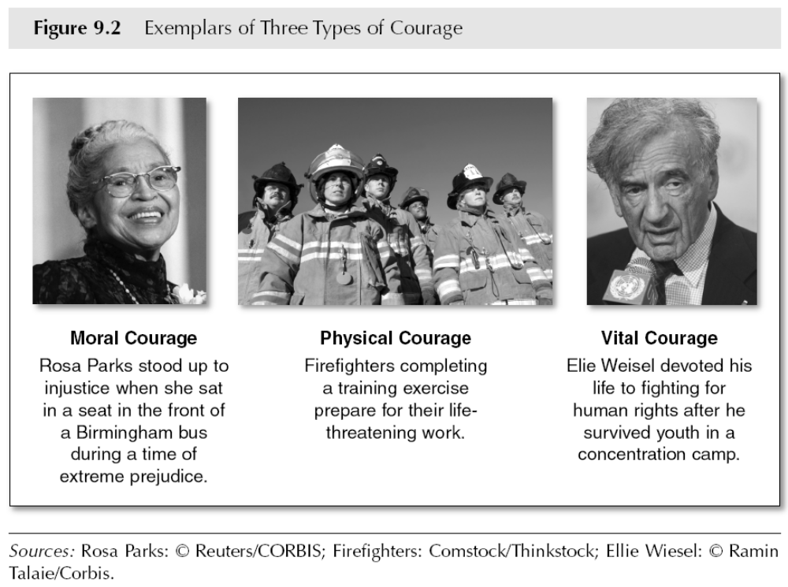
Implicit Theories of Courage
Positive Psychology: The Scientific and Practical Explorations of Human Strengths © 2014 SAGE

Slide 25
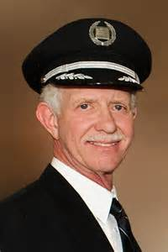
Physical Courage
Capt. Sullenberger and the “Miracle
on the Hudson” (2009)
Interview 5 years later
Positive Psychology: The Scientific and Practical Explorations of Human Strengths © 2014 SAGE

Slide 26
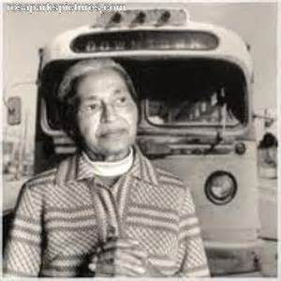
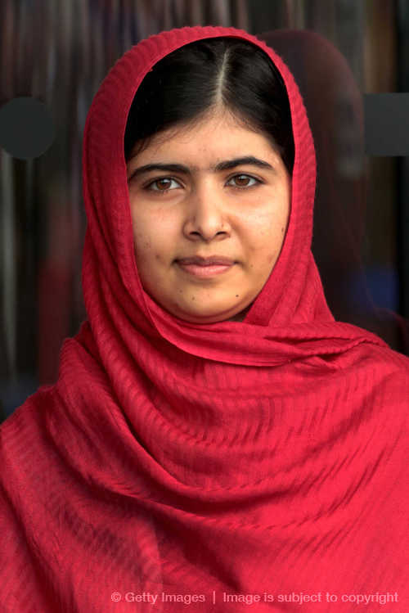
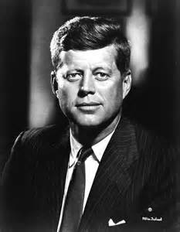
Moral Courage
Malala Yousafzai
Positive Psychology: The Scientific and Practical Explorations of Human Strengths © 2014 SAGE

Slide 27
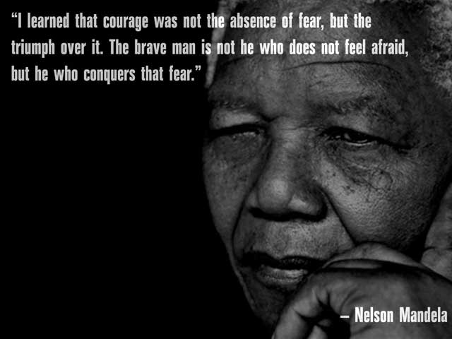
Moral Courage
Moral courage is “Standing up for values…the willingness to take a tough stand for right in the face of danger…the courage to do the right thing…the quality of mind and spirit than enables one to face up to ethical challenges firmly and confidently without flinching or retreating” (Kidder, 2006, p.72)
  Kidder directs the Institute of Global Ethics

Slide 28
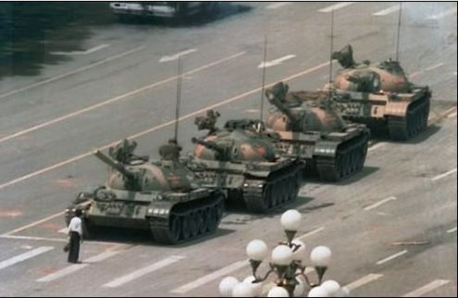
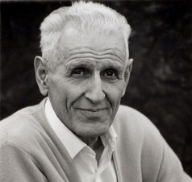
Kidder Moral Courage: 3 Components
Commit to core set of moral values and principles
Recognize we are likely to experience and face danger by standing up for these principles
  Physical threat, loss, rejection, shame, or disappointment
Must be willing to endure that danger and continue to do what we know is right, even if it means loss, disapproval, or shame
  Dr. Jack Kevorkian, publicly championed a terminal patient's right to die via physician-assisted suicide

Slide 29
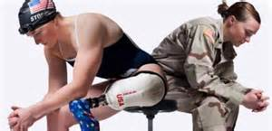
Vital Courage
Physicians, nurses, and other health professionals
Chronically ill adolescents
Case study: Army veteran Melissa Stockwell
Positive Psychology: The Scientific and Practical Explorations of Human Strengths © 2014 SAGE

Slide 30
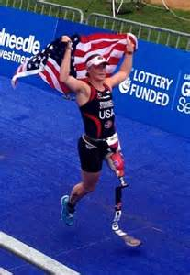
Melissa Stockwell
Melissa Stockwell
Interview
Her initial thoughts after waking up in the ER in Iraq after a roadside bomb took her leg was being thankful to have her life
When she got to Walter Reed Army Medical Center she thought she was one of the lucky ones
Positive Psychology: The Scientific and Practical Explorations of Human Strengths © 2014 SAGE

Slide 31
Implicit Theories of Courage
Putman (1997)
- Psychological courage:
strength in facing one’s destructive habits
a form of vital courage
Paucity of training for psychological courage
Positive Psychology: The Scientific and Practical Explorations of Human Strengths © 2014 SAGE

Slide 32
Empowering Women…sorry, not sorry
Pantene Sorry, Not Sorry Commercial
Positive Psychology: The Scientific and Practical Explorations of Human Strengths © 2014 SAGE

Slide 33
Implicit Theories of Courage
Greitemeyer and colleagues (2007)
- Civil Courage:
Brave behavior accompanied by anger and indignation that intends to enforce societal and ethical norms
Separate from altruism in that bodily harm is risked
Positive Psychology: The Scientific and Practical Explorations of Human Strengths © 2014 SAGE

Slide 34
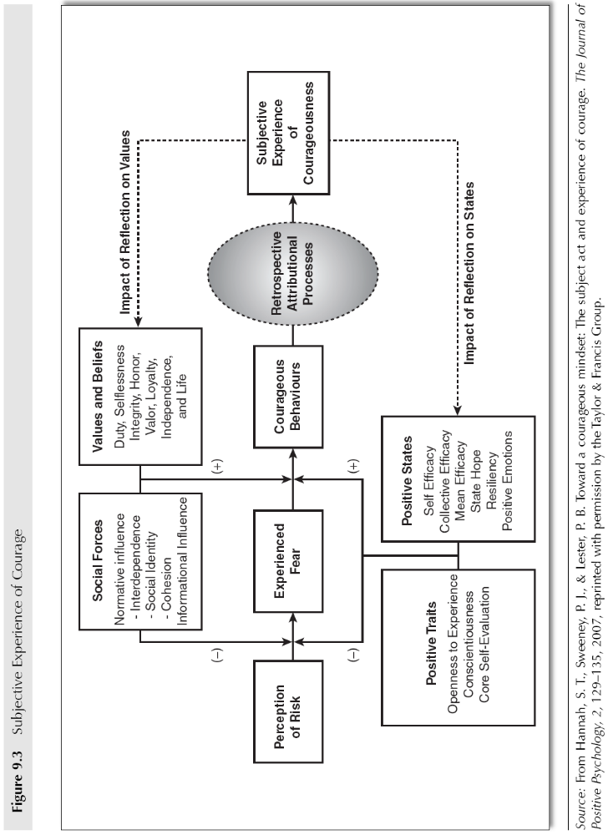
Becoming and Being Courageous
Positive Psychology: The Scientific and Practical Explorations of Human Strengths © 2014 SAGE
Notes:
Check figure number for this slide

Slide 35
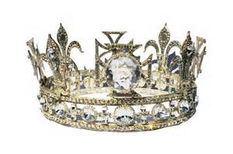
Posted to Facebook
One day she finally grasped that unexpected things were always going to happen in life. And with that she realized the only control she had was how she choose to handle them. So she made the decision to survive using courage, humor, and grace. She was the queen of her own life and the choice was hers.
Positive Psychology: The Scientific and Practical Explorations of Human Strengths © 2014 SAGE

Slide 36
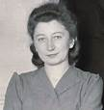
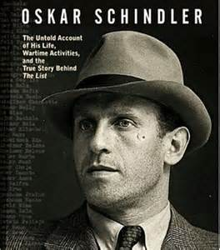
Courageous Altruism
Studied non-Jewish “rescuers” and “bystanders”
Differed in terms of:
  Social responsibility Miep Gies (hid Anne Frank)
  Empathic concern
  Risk taking
  Altruistic moral reasoning
Positive Psychology: The Scientific and Practical Explorations of Human Strengths © 2014 SAGE

Slide 37
The Measurement of Courage
Numerous brief self-report measures
Further development of measures needed
Woodard-Pury Courage Scale
VIA Inventory of Strengths
Positive Psychology: The Scientific and Practical Explorations of Human Strengths © 2014 SAGE

Slide 38
Relationships Between Fear & Courage
Relationship not well understood
Frightened people can perform courageous acts
Perseverance despite fear = pure courage
Positive Psychology: The Scientific and Practical Explorations of Human Strengths © 2014 SAGE

Slide 39
Undoing Fear Conditioning
When life knocks you down, get back up…as quickly as you can!
Memories are unstable/malleable for a short period of time, where if we add another experience it may create a new memory…alter consolidation of memory
New experience may not have to be so quick…Recent research suggests that each time a memory is retrieved, it is once again unstable for a brief period until it is reconsolidated
  Erasing Fear Memories

Slide 40
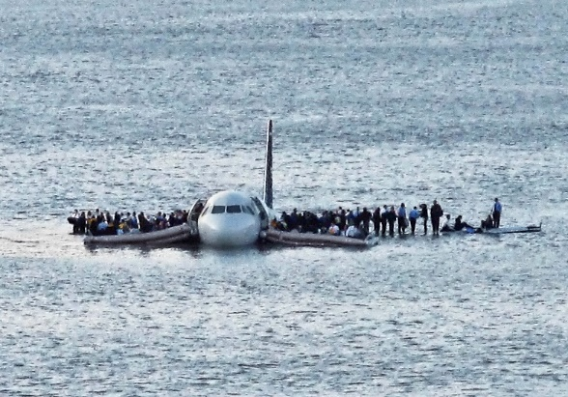
Practical Applications: Learning to Face Fear
View fear as a guide
  View fear as normal, not something to avoid
  Accept it, welcome it
  There is a difference between fear and panic
  Navy SEALS Mental Training
  Moderate levels of fear may sharpen focus and decision making
View fear as an opportunity
  To develop courage, self-esteem, a sense of mastery
Focus on the goal or mission
  Looking ahead for a bigger view of the situation
  Sullenberger Miracle on the Hudson
  “challenge of a lifetime” and also provided “opportunities”

Slide 41
Practical Applications: Learning to Face Fear
Acquire information about what is feared
  Helps to build self-efficacy
  Practice, practice, practice so not as overwhelmed or surprised by the unknown

Slide 42

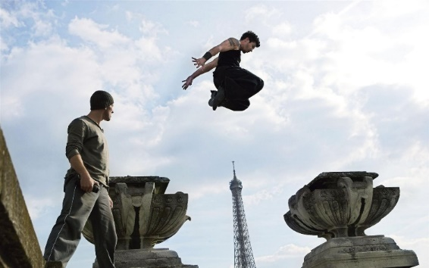
Practical Applications: Learning to Face Fear
Learn and practice the skills necessary to master the fear
  Helps to build self-efficacy…mastery experience
  Navy SEALS How to get over a wall
  David Belle and Parkour An Interview
Face fear with friends and colleagues
Face fear with spiritual support
Get someone or an organization to push you

Slide 43
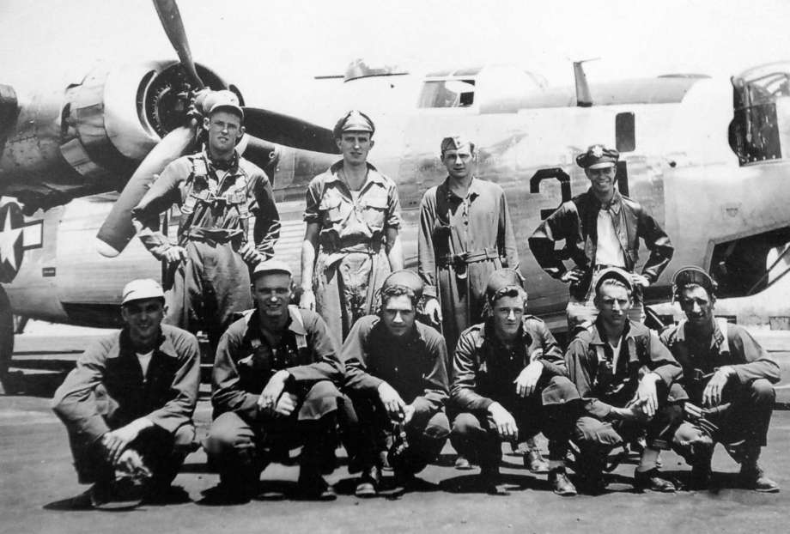
Practical Applications: Learning to Face Fear
Face fear with friends
and colleagues
Face fear with spiritual support
  Milton Klarsfeld, Albany businessman, WWII POW, upon capture was placed in a box for 10 days where he nearly starved to death. It was during this time that he planned out the rest of his life. It gave him hope for the future.
Get someone or an organization to push you

Slide 44
Benefits of Courage
Higher scores on courage associated with traits of agreeableness, extroversion, and openness
Courage negatively associated with anxiety
Courage correlated with more adaptive coping style, higher levels of confidence
Positive Psychology: The Scientific and Practical Explorations of Human Strengths © 2014 SAGE

Slide 45
Courage and Culture
Courage viewed differently in different cultures or subcultures
Asian cultures might consider the pursuit of harmony to be courageous
In other groups, speaking up – even at all costs – might be viewed as courageous
Some cultural groups find courage to be necessary more often than others
Courage may be a necessary component of life for women across the world
Positive Psychology: The Scientific and Practical Explorations of Human Strengths © 2014 SAGE

Slide 46
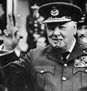
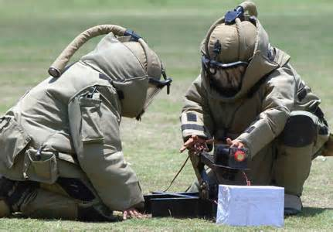
Finding Wisdom and Courage in Daily Life
Courage is the ability to act in spite of hardship, despair, and sometimes danger
Courage cannot be taught but it can be inspired or learned (Mansfield)
Profile of Winston Churchill
Studies of bomb disposal officers (Rachman)
  Being prepared, and knowing
  you are prepared
Positive Psychology: The Scientific and Practical Explorations of Human Strengths © 2014 SAGE

